Slide 1

CYBER HERO
- NSU_AIR
TEAM:
Alif Elham Khan
Mohammad Junayed Hasan

Slide 2

The Problem:
Confusion about being bullied online. How do you tell the difference between a joke and bullying?
Cyberbullying affects mental health
Unclear about reporting
Cannot confront cyberbullies?

Slide 3
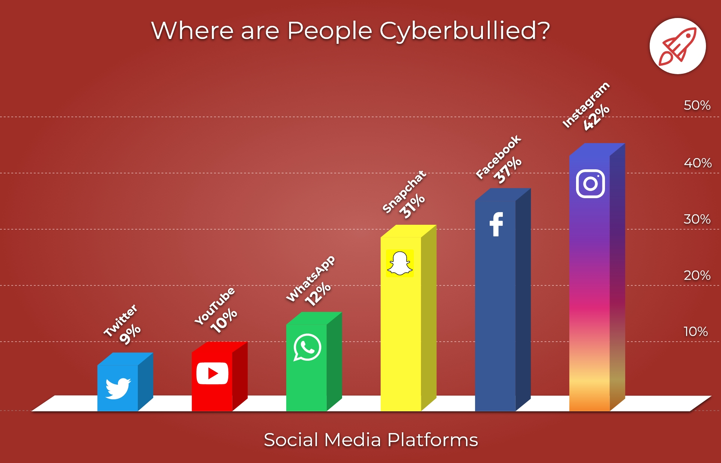
Background
Cyberbullying is bullying with the use of digital technologies. It is done for scaring, angering or shaming people.
There has been a surge in cyber bullying in recent times.

Slide 4

Our Solutions:
Anonymous Counselling Sessions
Reporting Tools
Help prevent personal information from being used to manipulate or humiliate people
Send emergency help

Slide 5

Technology
Simple UI
Easily Accessible Website
Secured Login

Slide 6


Our Vision
To establish reporting practices
To make counselling sessions easily accessible
To eradicate cyber bullying

Slide 7

Build Technology
JAVA (Spring Boot)
Firestore Cloud Database
React Frontend
JAVA Token based Authentication
Maven

Slide 8
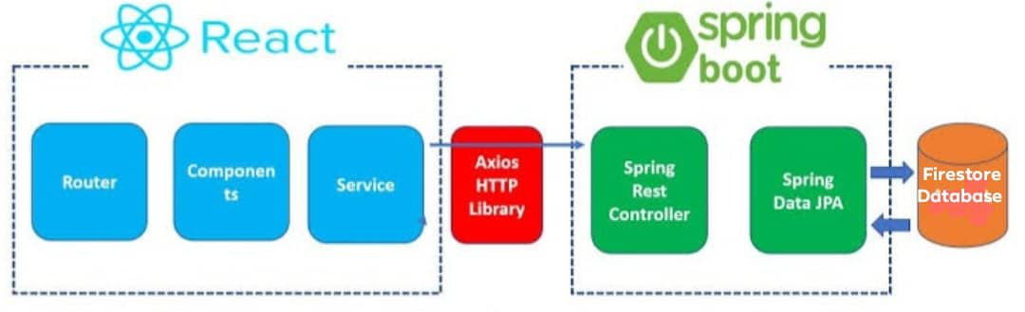
System Structure

Slide 9

Feasibility
1
Cheap
Easily Accessible
Existing Reporting Tools
Existing Demand

Slide 10

Business Model
1
Joint Venture partners: Mobile operators, Bangladesh Police, Police Cyber for Women
Strategic Alliance: Counselling centers
Funding: Bangladesh ICT Department

Slide 11

Marketing Plan
1
Facebook Advertisement in official page of Police Cyber ​​Support for Women (PCSW), Bangladesh Police
TV Commercial in partnership with Bangladesh Police
Joint venture with mobile operators to advertise about our app.

Slide 12
THANK YOU

